Slide 1

CS FYP weekly Presentation
Caleb Mok
2689719m
29/11/2024

Slide 2
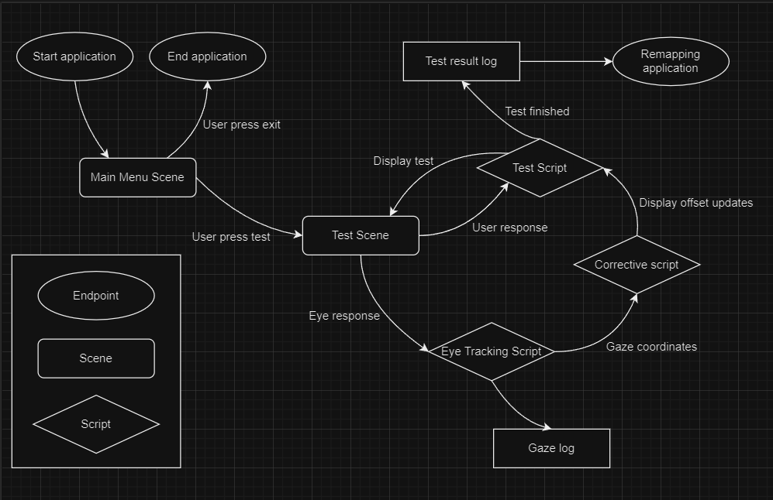
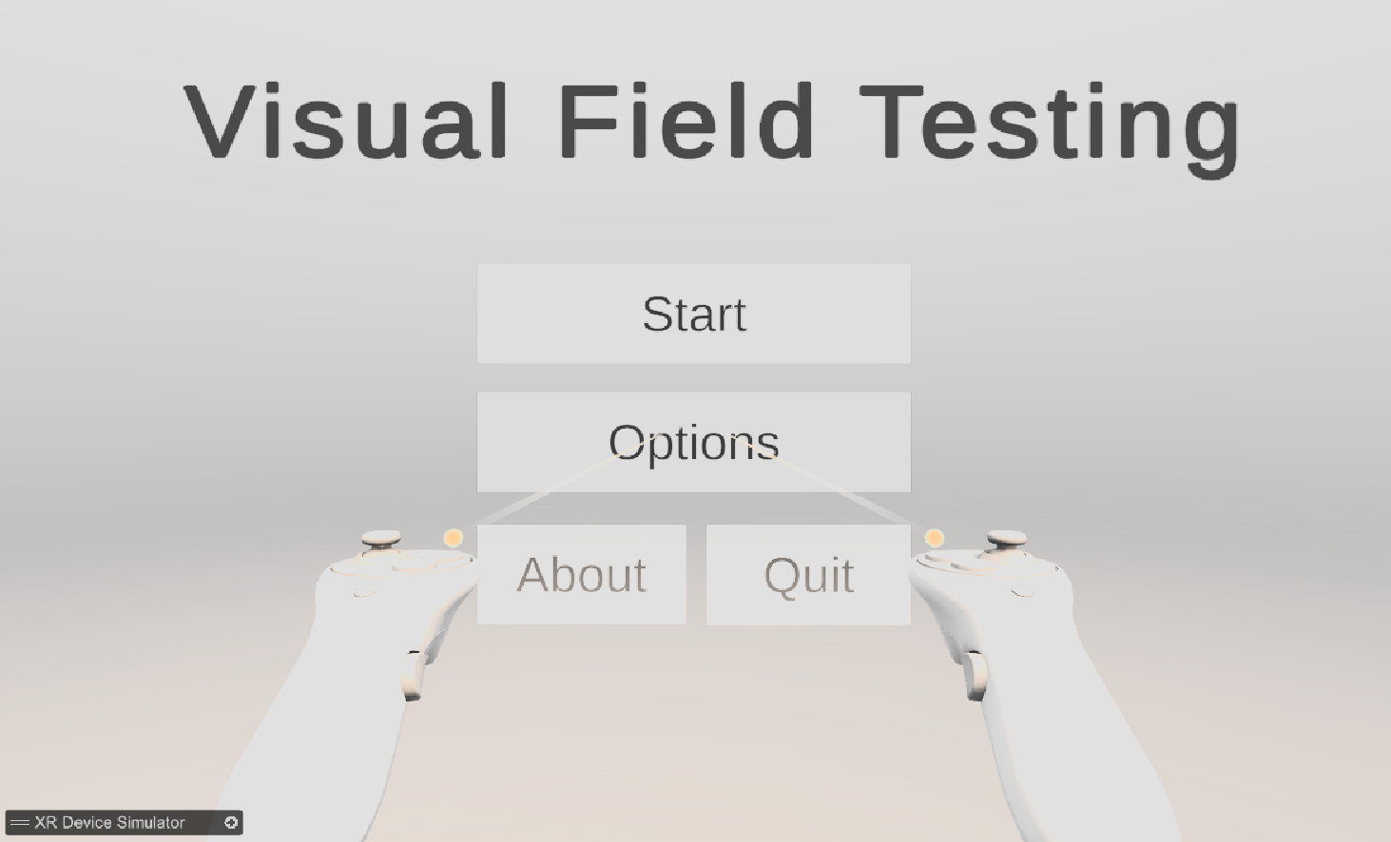
What I had prior and currently trying to do
I added a Start Scene that directs the user to the visual testing scene after clicking on the start button, and also added other basic buttons such as options, about, and a quit button.

Slide 3
What I achieved this week
I’ve made a Figma prototype that demonstrate what I meant to do with my project and finished 2 extra literature reviews.

Slide 4
What I plan to do next
I plan to continue developing my Figma prototype, and want to demonstrate my prototype to a few close friends for any design ideas to implement.
I still plan to refine the visual field-testing scene to detect user inputs to start getting usable data and attempt to export the data in a readable format.
Get the VR headset in the lab running so I can start testing my application.

Slide 5
Literature Review

Slide 6
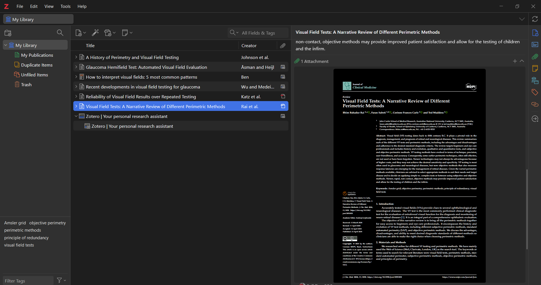
What I achieved this week
I’ve reorganized my literature review, and successfully set up a reference manager (Zotero) to link with Overleaf for easier referencing in the future. I’ve also added a few papers that I’ve briefly read through and deemed important into my review. Some papers I’ve not added into the review, but they are saved in Zotero, and I will analyse them further.
I’ve also started work on making a basic high-level process flow diagram for my project, designed different scenes I expect my project to have and also the scripts needed to run the project.

Slide 7
What I am trying to do

